Slide 1
Production and usage of Cryptocurrencies
Attila Pethő and Róbert Tóth, MSc student University of Debrecen
Tanszéki értekezlet, Debrecen, 2019.03.06.
Florian Tschorsch and Björn Scheuermann,
Bitcoin and Beyond: A Technical Survey on Decentralized Digital Currencies, 2015 felhasználásával.

Slide 2
Cryptocurrencies
Bitcoin, Ethereum, Litecoin, NEO, Ripple XRP, Monero….
 | Anonymity | Account | Ledger
Cash | Yes | No | No
Bank card | No | Yes | Centralized
Digital money | Yes | Yes | Decentralized

Slide 3
Problems to solve
Anonymity
Double spend coins
„Production” of coins
Change and merge coins
Distribution of the ledger (főkönyv)
Mutual agreement on a consistent state in the presence of selfish and/or malicious participants.
Asymmetric or public key cryptography made possible the solution.

Slide 4
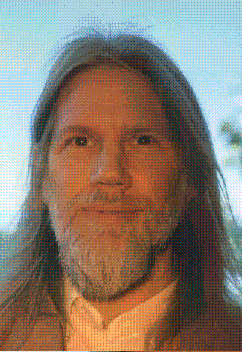
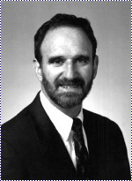
Discoverer of public key cryptography
Whitfield Diffie
Martin E. Hellman
New Directions in Cryptography, IEEE Trans on Inform. Theory, November 1976

Slide 5
They wrote 42 years ago
[…] applications create a need for new types of cryptographic systems which minimize the necessity of secure key distribution channels and supply the equivalent of a written signature.
The development of computer controlled communication networks promise effortless and inexpensive contact between people or computers on opposite sides of the world, replacing most mail and many excursions with telecommunications.
This is now reality!

Slide 6
Asymmetric cryptography
Is based on hard discrete mathematical, mainly on number theoretical problems
Factorization
Discrete logarithm
Discrete elliptic logarithm
Shortest vector in a lattice
Error-correcting codes, etc.

Slide 7
Scheme of digital signature
Necessary algorithms
Key generation algorithm
Signing algorithm
Signature verifying algorithm
Additional
Hash function, like classical telephon book

Slide 8
Model of digital signature
Verifier
Hash function
Secret key
Public key
Message + Public key
Message fingerprint
Signed fingerprint
Fingerprint1
=
=?
Fingerprint2
yes
no
Signer
Hash function

Slide 9
Blind signature
David Chaum, 1982
The signer does not no the content of the document
Many applications
E-cash
E-voting
E-exam, etc.

Slide 10
Transferring a coin through a bank
Kriszta signs and anounces a transaction of the following form: “I transfer coin #1210 to Aladár”.
Aladár verifies the ownership of coin #1210 by consulting the bank.
If the transaction is valid and Aladár accepts the transaction, the bank updates its ledger.
In this moment the owner of the coin changes from Kriszta to Aladár.

Slide 11
the Bitcoin
Satoshi nakamoto, 2008

Slide 12
Bitcoin aims
To gets rid of the central bank mechanisms are needed
to create coins in a distributed setting,
to store and manage the ledger in a distributed way.
The key challenge is to achieve consensus
on existing coins
and their ownership
without a central instance, and without mutual trust relationships between participants.

Slide 13
Privacy models

Slide 14
the Bitcoin
Bitcoin cleverly combines existing contributions from decades of research
It solved fundamental problems in a highly sophisticated, original and practically viable way: it uses a proof of work scheme to limit the number of votes per entity, and thus renders decentralization practical.
Basic structure: block chain

Slide 15
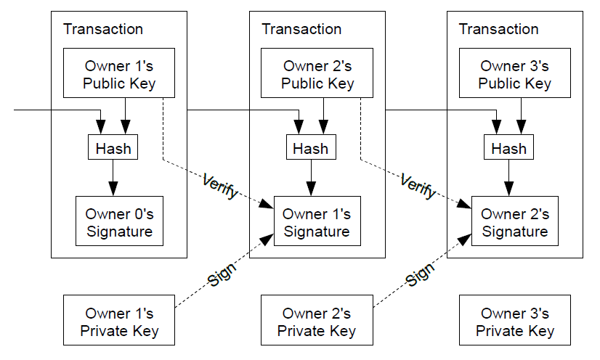
Blockchain: list of blocks linked by hash values and by digital signatures

Slide 16
PROOF-of-Work aim
Each participant has a copy of the block chain, which she/he can modify → inconsistency
Kriszta can transfer the same coin to two different members.
Bitcoin’s solution: the entire network verify the legitimacy of the transactions → majority voting
Kriszta can do Sybil attack: she sets up many instances all con-
firming the transaction. → proof-of-work
Notes:
IP címek CPU helyett

Slide 17
PROOF-of-Work
Before spreading the news about the verification of a transaction, users have to perform work to proof they are “real” identities.
The work is a cryptographic puzzle. It is hard to find a solution, but easy to check it.
Hash(block+nonce) < target
Finding somebody an appropriate nonce, creates and appends the new block to the chain and broadcasts it the community → everybody update its blockchain with the same new block → consistency remain.
Notes:
IP címek CPU helyett

Slide 18
Proof-of-Work

Slide 19
Proof-of-work properties
The ability of verification of a transaction depends on the computing power, and not on the number of participants. (CPU-based voting instead of IP based.)
A block can not be altered without the recomputation of the complete block chain after it.
Why should anyone solve this puzzle and waste computation time (money) for verifying and certifying other people’s transactions?

Slide 20
operations of a block chain
Announcement of new transactions.
The nodes collect the new transactions in a block.
The nodes seach for a proof-of-work (nonce).
If a node finds one broadcast it to the other nodes.
The first node, who broadcasts a valid nonce gets some amount of bitcoins (at the beginning 50, nowadays 12.5).
This process is called mining.
Notes:
Azonos hosszúságúk esete

Slide 21
Simplified verification
The complete Bitcoin block chain is over 200 GB →full nodes, thin clients
A thin client, e.g. cell phone, needs the block headers only and requests transactions on demand.
The block header, about 80 bytes, incorporates a Merkle root, which secures the transactions by constructing a hash tree over their transaction IDs.
Allows clients to verify that a transaction is part of a block.

Slide 22
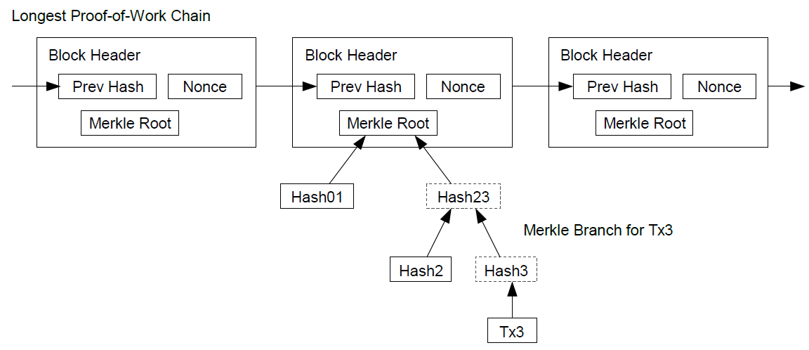
Simplified block chain

Slide 23
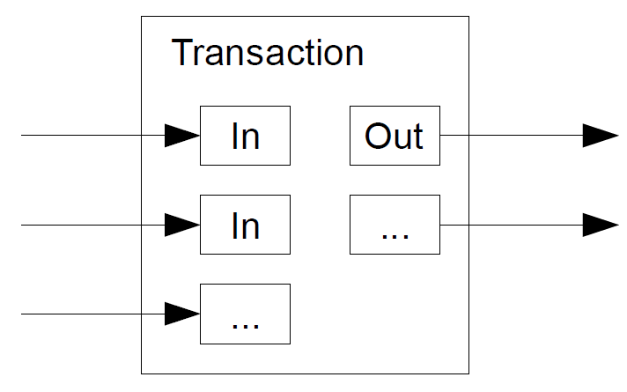
Joining and change of bitcoins

Slide 24
Future
I am not sure that Bitcoin and the other actual cryptocurrencies survive long run. Are they robust enough?
Technically yes, the Bitcoin is10 years young or old, but
Political and social impact
The block chain technology found many other applications
The demand for cryptocurrences remains → new attempts to find better solutions.

Slide 25
Vielen dank für zuhören!

