Slide 1
Test automation goals, decisions. Test automation approaches. Behavior based testing.
Horváth Anita, EPAM
Anita_Horvath@epam.com
CONFIDENTIAL | © 2020 EPAM Systems, Inc.

Slide 2

Test automation

Slide 3
Benefits of test automation
saving time and workforce with avoiding repeated manual work
ensure that we always execute tests consistently (elimination of human error)
reduce the difficult manual tests of multilingual sites
increase the speed of test execution
getting faster feedback
run daily tests (overnight, then get the report every morning)
test different environments at the same time
<szám>

Slide 4
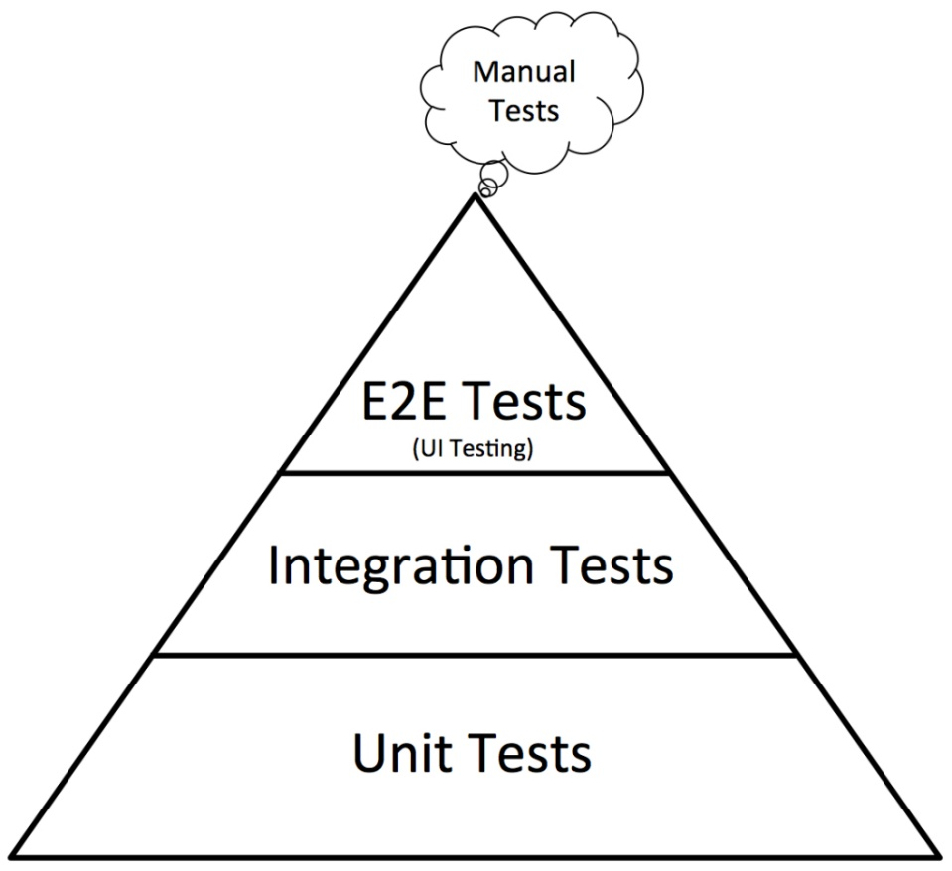
Test automation pyramid
Testing Pyramid is a framework that can help both developers and QAs create high-quality software.
It reduces the time required for developers to identify if a change they introduced breaks the code.
It can also be helpful in building a more reliable test suite.
The test automation pyramid operates at three levels:
  Unit tests
  Integration tests
  End-to-End tests
https://www.browserstack.com/guide/testing-pyramid-for-test-automation
<szám>

Slide 5
Test automation approaches

Slide 6
Main questions
Can we automate our manual tests?
Certain test types can only be executed in an automated way (e.g. stress tests, load tests)
How frequently should the tests be run?
Another key factor is the complexity of the tests
How many tests do we have? Should we parallelize them?
Are the tests dependent of each other?
What preconditions are required before test execution?
What kind of tool do we need? (tools for test automation can be expensive)
<szám>

Slide 7
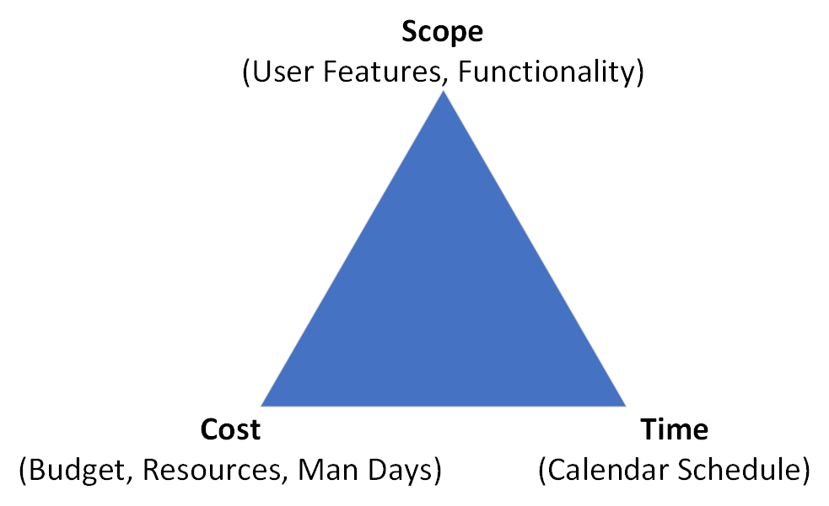
Time-quality-budget triangle
Quality
https://www.enterprise-pm.com/pmbasics/triple-constraint/
<szám>

Slide 8
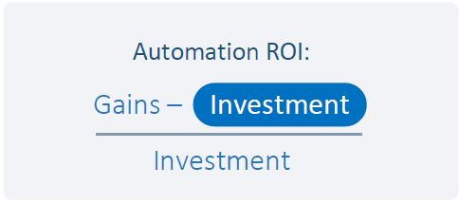
Return of investment
The return on the investment measures the overall profit on an investment expressed as a percentage of the amount invested.
https://smartbear.com/resources/ebooks/6-ways-to-measure-the-roi-of-automated-testing/
<szám>

Slide 9
Prioritizing
Which tests should be automated
business critical test cases (with high risk)
test cases which are executed repeatedly
tests which are difficult to perform manually
time consuming tests
Tests not suitable for automation
actions which should be performed just a few times
features which are changing to often
test cases which are faster to test manually rather than develop automated tests for them
<szám>

Slide 10
Behavior Based Testing

Slide 11
BDD & BDT Advantages
BDD - Behavior Driven Development
BDT – Behavior DRIVEN Testing
It involves getting stakeholders and delivery team with different perspectives onto the same page and ensuring that all have the same expectations.
BDD starts with a business goal that translates to features and stories.
The goal of BDT is a business readable and domain specific language that allows you to describe a system’s behavior without detailing how that behavior is implemented.
In BDT, the feature descriptions with scenarios are typically written before anything else and they are verified by the non-technical stakeholders.
<szám>

Slide 12
Gherkin
https://www.guru99.com/gherkin-test-cucumber.html
<szám>

Slide 13
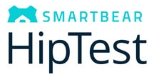


Tools and testing frameworks
Hiptest - the only continuous testing tool with native support
Cucumber – free to use; as a tool maintains both the requirement statement and the Test conditions in the same place
Easy B - is mostly written with Groovy and is compatible to work with Java or Groovy languages; mostly used in unit testing
Jdave
Concordion
Jbehave
Fitnesse
TestLeft
BeanSpec
SpecFlow
https://www.softwaretestinghelp.com/behavior-driven-development-bdd-tools/
<szám>

Slide 14
Gherkin syntax
Feature: Short description of the feature
Scenario: Title of the proper test case
Given [Precondition or Initial Context]
And [Another precondition]
When [Event or Trigger]
Then [Expected output]
<szám>

Slide 15
Important terms used in Gherkin
Feature
Background
Scenario
Given
When
Then
And
But
Scenario Outline & Examples (https://cucumber.io/docs/gherkin/reference/ )
<szám>

Slide 16
Practice
https://www.spotify.com/hu/
Gather all test cases for the registration form
Write feature file for it:
  Pull the framework from Gitlab: https://gitlab.com/unideb-szoftverteszteles/spotify
    Open a cmd or gitbash and go to the right place
    Type: git clone https://gitlab.com/unideb-szoftverteszteles/spotify.git
  Open the project in IntelliJ IDEA
  Create the spotify.feature under the feature-files package
<szám>

Slide 17
Thank you for your attention
<szám>

