Slide 1
Data Structures and Algorithms
Hash Tables

Slide 2
Hash Tables
Concepts
Collision handling methods
Examples
Exercises

Slide 3
What is a Hash Table?
A data structure that stores elements using a hash function.
The hash function maps a key to a specific slot in a table.
Notation: h(k) → slot index.

Slide 4
Hash Function
Maps keys from universe U to table slots.
h: U → {0,1,...,m−1}
Table size m is usually much smaller than the number of possible keys.

Slide 5
Division Method
One of the most common hash functions.
Formula: h(k) = k mod m
Example: m = 12, k = 100 → h(k) = 4

Slide 6
Collision Problem
Collision occurs when two keys map to the same slot.
Example: h(k1) = h(k2).
Different techniques are used to resolve collisions.
REMARK
When handling collision, always pay attention to the order of the input data!

Slide 7
Collision Handling Methods
Open Addressing
Open Addressing with Chaining
Separate Chaining with Linked Lists

Slide 8
Open Addressing
If a collision occurs, search for the next free slot.
Linear probing formula:
new_slot = (current_slot + 1) mod table_size

Slide 9
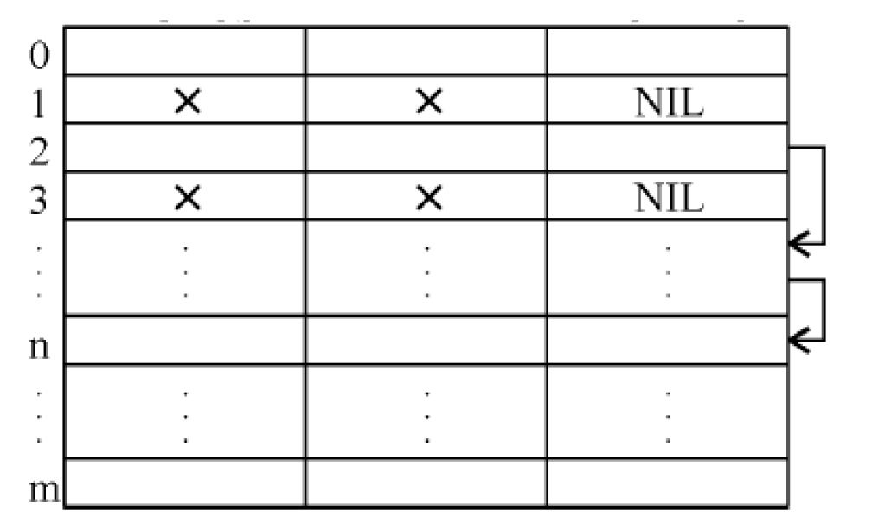
Open Addressing with Chaining
Uses an additional column called Pointer.
The pointer stores the index of overflow elements.
The index of the overflow value is stored in the pointer column.
If there is no overflow, we place the NIL pointer.

Slide 10
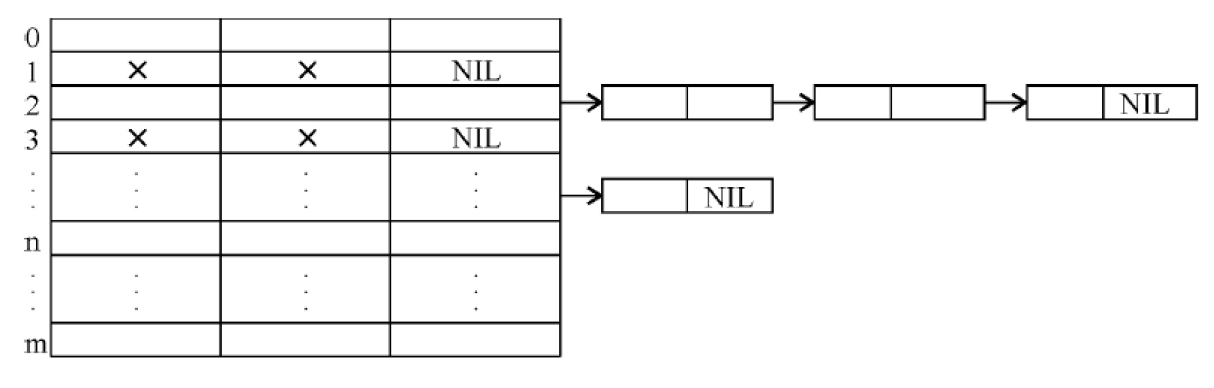
Separate Chaining with Linked List
All elements that hash to the same slot are stored
in a linked list attached to that slot

Slide 11
Exercise 1
There is a hash table which is capable of storing 9 elements. Define the hash function with the division method. The following key-value pairs are given:
19 | Blue
27 | Red
51 | Green
13 | Blue
37 | Brown
31 | Pink
25 | orange
Place the elements in the table using the following methods:
Open addressing
Open addressing with chaining
Separate chaining with linked list

Slide 12
Solution
m = 9 (size of the table)
h(k) = k mod 9
Open addressing:
 | Key | Value
0 | 27 | Red
1 | 19 | Blue
2 | 37 | Brown
3
4 | 13 | Blue
5 | 31 | Pink
6 | 51 | Green
7 | 25 | Orange
8

Slide 13
Open addressing with chaining
 | Key | Value | Pointer
0 | 27 | Red | NIL
1 | 19 | Blue | 2
2 | 37 | Brown | NIL
3
4 | 13 | Blue | 5
5 | 31 | Pink | NIL
6 | 51 | Green | NIL
7 | 25 | Orange | NIL
8

Slide 14
Separate chaining with linked list:
 | Key | Value | Pointer
0 | 27 | Red | NIL
1 | 19 | Blue
2
3
4 | 13 | Blue
5
6 | 51 | Green | NIL
7 | 25 | Orange | NIL
8
37 | Brown | NIL
31 | Pink | NIL

Slide 15
Exercise 2
There is a hash table which is capable of storing 9 elements. Define the hash function with the division method. The following key-value pairs are given:
2 | Honda
7 | Suzuki
9 | Mercedes
15 | Opel
18 | Ford
14 | BMW
11 | Toyota
21 | Tesla
Place the elements in the table using the following methods:
Open addressing
Open addressing with chaining
Separate chaining with linked list

Slide 16
Solution
m = 9 (size of the table)
h(k) = k mod 9
Open addressing:
 | Key | Value
0 | 9 | Mercedes
1 | 18 | Ford
2 | 2 | Honda
3 | 11 | Toyota
4 | 21 | Tesla
5 | 14 | BMW
6 | 15 | Opel
7 | 7 | Suzuki
8

Slide 17
Open addressing with chaining
 | Key | Value | Pointer
0 | 9 | Mercedes | 1
1 | 18 | Ford | NIL
2 | 2 | Honda | 3
3 | 11 | Toyota | 4
4 | 21 | Tesla | NIL
5 | 14 | BMW | NIL
6 | 15 | Opel | NIL
7 | 7 | Suzuki | NIL
8

Slide 18
Separate chaining with linked list:
 | Key | Value | Pointer
0 | 9 | Mercedes
1
2 | 2 | Honda
3 | 21 | Tesla | NIL
4
5 | 14 | BMW | NIL
6 | 15 | Opel | NIL
7 | 7 | Suzuki | NIL
8
18 | Ford | NIL
11 | Toyota | NIL

Slide 19
Exercise 3
There is a hash table which is capable of storing 14 elements. Define the hash function with the division method. The following key-value pairs are given:
19 | Blue
27 | Red
51 | Green
12 | Blue
37 | Brown
31 | Pink
17 | Orange
32 | White
16 | Black
34 | Yellow
22 | Purple
30 | Gold
Place the elements in the table using the following methods:
Open addressing
Open addressing with chaining
Separate chaining with linked list

Slide 20
Solution
Open addressing:
 | Key | Value
0
1
2 | 16 | Black
3 | 31 | Pink
4 | 17 | Orange
5 | 19 | Blue
6 | 32 | White
7 | 34 | Yellow
8 | 22 | Purple
9 | 51 | Green
10 | 37 | Brown
11 | 30 | Gold
12 | 12 | Blue
13 | 27 | Red
m = 14 (size of the table)
h(k) = k mod 14

Slide 21
Open addressing with chaining
 | Key | Value | Pointer
0
1
2 | 16 | Black | 11
3 | 31 | Pink | 4
4 | 17 | Orange | 6
5 | 19 | Blue | NIL
6 | 32 | White | 7
7 | 34 | Yellow | NIL
8 | 22 | Purple | NIL
9 | 51 | Green | 10
10 | 37 | Brown | NIL
11 | 30 | Gold | NIL
12 | 12 | Blue | NIL
13 | 27 | Red | NIL

Slide 22
Separate chaining with linked list:
 | Key | Value | Pointer
0
1
2 | 16 | Black
3 | 31 | Pink
4 | 32 | White | NIL
5 | 19 | Blue | NIL
6 | 34 | Yellow | NIL
7
8 | 22 | Purple | NIL
9 | 51 | Green
10
11
12 | 12 | Blue | NIL
13 | 27 | Red | NIL
30 | Gold | NIL
17 | Orange | NIL
37 | Brown | NIL

Slide 23
Exercise 4
There is a hash table which is capable of storing 16 elements. Define the hash function with the division method. The following key-value pairs are given:
2 | Canada
7 | USA
19 | Germany
15 | France
26 | Hungary
34 | Romania
21 | Spain
28 | Portugal
20 | Brazil
55 | China
37 | Turkey
48 | Argentina
74 | Denmark
Place the elements in the table using the following methods:
Open addressing
Open addressing with chaining
Separate chaining with linked list

Slide 24
Solution
 | Key | Value
0 | 48 | Argentina
1
2 | 2 | Canada
3 | 19 | Germany
4 | 34 | Romania
5 | 21 | Spain
6 | 20 | Brazil
7 | 7 | USA
8 | 55 | China
9 | 37 | Turkey
10 | 26 | Hungary
11 | 74 | Denmark
12 | 28 | Portugal
13
14
15 | 15 | France
m = 16 (size of the table)
h(k) = k mod 16
Open addressing:

Slide 25
 | Key | Value | Pointer
0 | 48 | Argentina | NIL
1
2 | 2 | Canada | 4
3 | 19 | Germany | NIL
4 | 34 | Romania | 6
5 | 21 | Spain | 9
6 | 20 | Brazil | NIL
7 | 7 | USA | 8
8 | 55 | China | NIL
9 | 37 | Turkey | NIL
10 | 26 | Hungary | 11
11 | 74 | Denmark | NIL
12 | 28 | Portugal | NIL
13
14
15 | 15 | France | NIL
Open addressing with chaining

Slide 26
Separate chaining with linked list:
 | Key | Value | Pointer
0 | 48 | Argentina
1
2 | 2 | Canada
3 | 19 | Germany
4 | 20 | Brazil
5 | 21 | Spain
6
7 | 7 | USA
8
9
10 | 26 | Hungary
11
12 | 28 | Portugal
13
14
15 | 15 | France
34 | Romania | NIL
37 | Turkey | NIL
55 | China | NIL
74 | Denmark | NIL

