Slide 1
Algorithm Complexity
(Big-O and Theta)
Notes:
Introduce the topic and explain why efficiency matters in programming.

Slide 2
What is Algorithm Complexity?
Measures efficiency of algorithms
Based on input size (n)
Focus on Time Complexity
Predicts scalability
Notes:
Explain that complexity measures growth, not exact time. Emphasize input size n.

Slide 3
Why Study Complexity?
Compare multiple algorithms
Choose best solution
Important for large datasets
Used in real-world systems
Notes:
Give real-life example: searching contacts vs searching millions of records.

Slide 4
Big-O Notation (Definition)
f(n) = O(g(n))
If ∃ c > 0 and m such that:
f(n) ≤ c g(n) for all n ≥ m
Represents worst-case growth
Notes:
Explain worst-case meaning and ignoring constants.

Slide 5
Theta (Θ) Notation
f(n) = Θ(g(n))
If c1 g(n) ≤ f(n) ≤ c2 g(n)
Represents tight (exact) bound
Used for precise growth rate
Notes:
Explain difference between O and Θ clearly.

Slide 6
Example 1: Simple Loop
for i in range(n):
print(i)
Time Complexity: O(n)
Notes:
Runs n times. Linear growth.

Slide 7
Example 2: Nested Loop
for i in range(n):
for j in range(n):
print(i, j)
Time Complexity: O(n²)
Notes:
n multiplied by n gives quadratic growth.

Slide 8
Example 3: Logarithmic Loop
i = 1
while i < n:
i = i * 2
Time Complexity: O(log n)
Notes:
Explain doubling pattern and relation to binary search.

Slide 9
Practice Problem 1
for i in range(n):
for j in range(i):
print(i, j)
Answer: O(n²)
Notes:
Explain triangular series sum formula n(n-1)/2.

Slide 10
Practice Problem 2
f(n) = 4n³ + 2n + 10
Find Θ notation
Answer: Θ(n³)
Notes:
Emphasize dominant term rule.

Slide 11
Key Takeaways
• Focus on dominant term
• Ignore constants
• Big-O → Worst case
• Theta → Tight bound
• Essential for efficient coding
Notes:
Summarize the entire lecture and take questions.

Slide 12
Exercise 1: Simple Loop
for i = 1 to n:
print(i)
Question: What is the running time?

Slide 13
Solution 1
The loop runs n times.
Each iteration is constant time.
Θ(n)

Slide 14
Exercise 2: Nested Loops
for i = 1 to n:
for j = 1 to n:
print(i, j)
Question: Running time?

Slide 15
Solution 2
Outer loop: n
Inner loop: n
Total operations: n × n = n²
Θ(n²)

Slide 16
Exercise 3: Triangular Loop
for i = 1 to n:
for j = 1 to i:
print(i, j)

Slide 17
Solution 3
Total work:
1 + 2 + ... + n = n(n+1)/2
Θ(n²)

Slide 18
Exercise 4: Logarithmic Loop
i = n
while i > 1:
i = i / 2

Slide 19
Solution 4
i halves each iteration
Number of iterations: log₂ n
Θ(log n)

Slide 20
Exercise 5: Mixed Loops
for i = 1 to n:
j = 1
while j ≤ n:
j = j × 2

Slide 21
Solution 5
Outer loop: n
Inner loop: log n
Θ(n log n)

Slide 22
Summary
Nested loops multiply
Halving leads to log n
Many divide-and-conquer algorithms are n log n

Slide 23
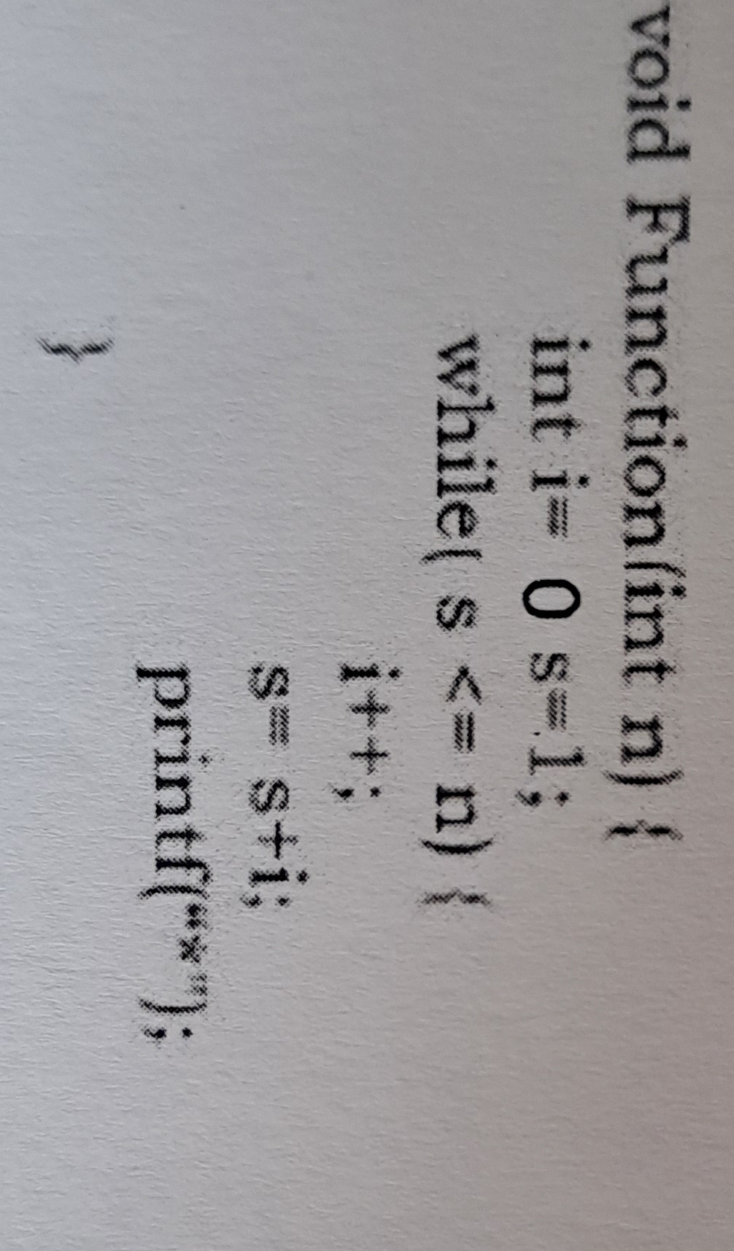
Exercise I
Determine the time complexity of the following algorithm!

Slide 24
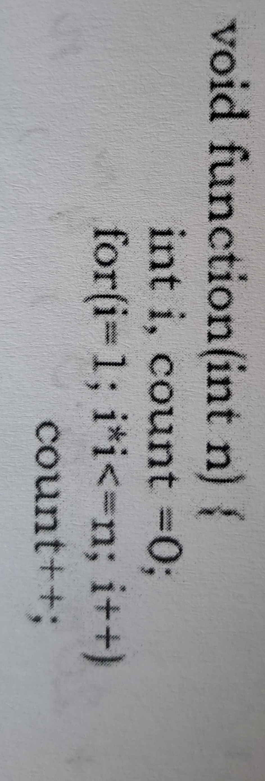
Exercise II
Determine the time complexity of the following algorithm!

Slide 25
Exercise III
Which of the following claims are correct?
(n+k)^m = Θ(n^m)
2^(n+1) = O(2^n)
2^(2n+1) = O(2^n)
1. and 2.
1. and 3.
2. and 3.
1.,2. and 3.

Slide 26
Exercise IV
Rank the following functions by order of growth:
(n+1)!, n!, 4^n, n*3^n, 3^n+n^2+20n, (3/2)n, n^2+200, 20n+500, 2^(lg n), n^(2/3), 1

