Slide 1
Stack and Queue representations
Data Structures and Algorithms
Debrecen, 2026

Slide 2
Stack (Verem) Representation
Let S be a stack containing numbers.
We implement it with an array S[1..n].
S.top stores the index of the most recently inserted element.
LIFO principle (Last-in-first-out)

Slide 3
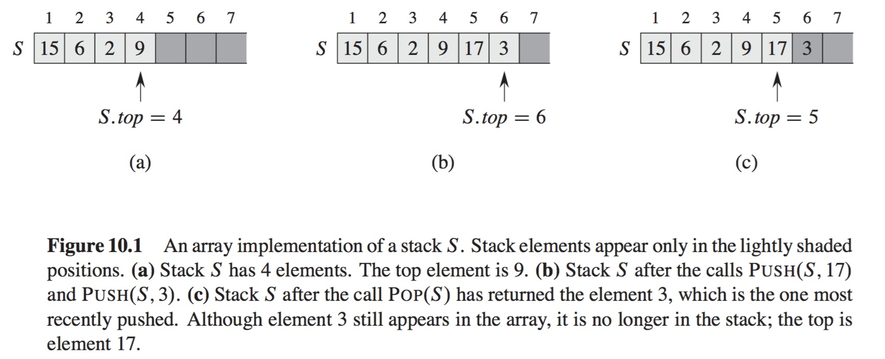
Stack representation

Slide 4
Stack Representation – Exercise 1
Using the following figure, illustrate the result of each operation in the sequence
PUSH(S,3)
PUSH(S,9)
PUSH(S,2)
POP(S)
PUSH(S,1)
POP(S)
POP(S)
PUSH(S,4)
PUSH(S,7)
on an initially empty stack S stored in array S[1..6].

Slide 5
Operation 1 2 3 4 5 6 S.top

Slide 6
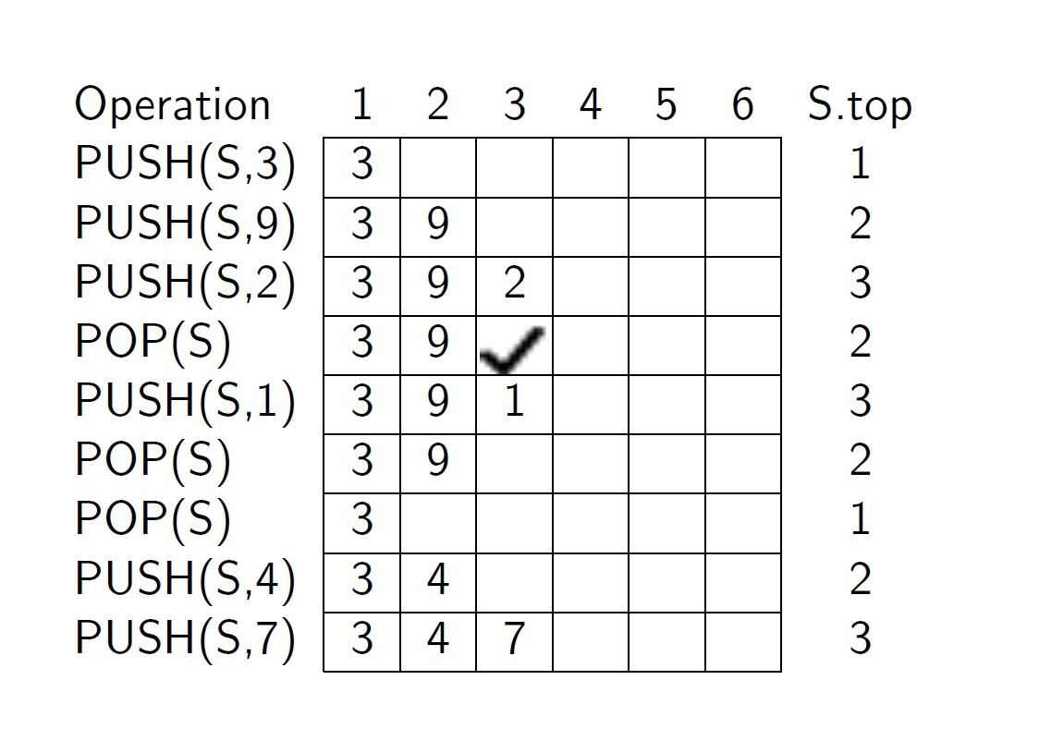
Solution

Slide 7
Stack Representation – Exercise 2
PUSH(S,1)
PUSH(S,5)
POP(S)
PUSH(S,2)
POP(S)
POP(S)
PUSH(S,3)
POP(S)
POP(S)
on an initially empty stack S stored in array S[1..5].

Slide 8
Exercise 2 – Solution
Operation | Stack state
PUSH(S,1) | 1
PUSH(S,5) | 1 5
POP(S) | 1
PUSH(S,2) | 1 2
POP(S) | 1
POP(S) | empty
PUSH(S,3) | 3
POP(S) | empty
POP(S) | underflow

Slide 9
Stack Representation – Exercise 3
PUSH(S,8)
PUSH(S,6)
POP(S)
PUSH(S,5)
PUSH(S,1)
PUSH(S,9)
POP(S)
PUSH(S,2)
PUSH(S,4)
PUSH(S,7)
on an initially empty stack S stored in array S[1..5].

Slide 10
Exercise 3 – Solution
Operation | Stack state
PUSH(S,8) | 8
PUSH(S,6) | 8 6
POP(S) | 8
PUSH(S,5) | 8 5
PUSH(S,1) | 8 5 1
PUSH(S,9) | 8 5 1 9
POP(S) | 8 5 1
PUSH(S,2) | 8 5 1 2
PUSH(S,4) | 8 5 1 2 4
PUSH(S,7) | overflow

Slide 11
Exercise 4 – Two Stacks in One Array
Implement two stacks in a single array A[1..n].
Stack1 grows from the beginning.
Stack2 grows from the end.
No overflow occurs unless the total elements equal n.
PUSH and POP must run in O(1).

Slide 12
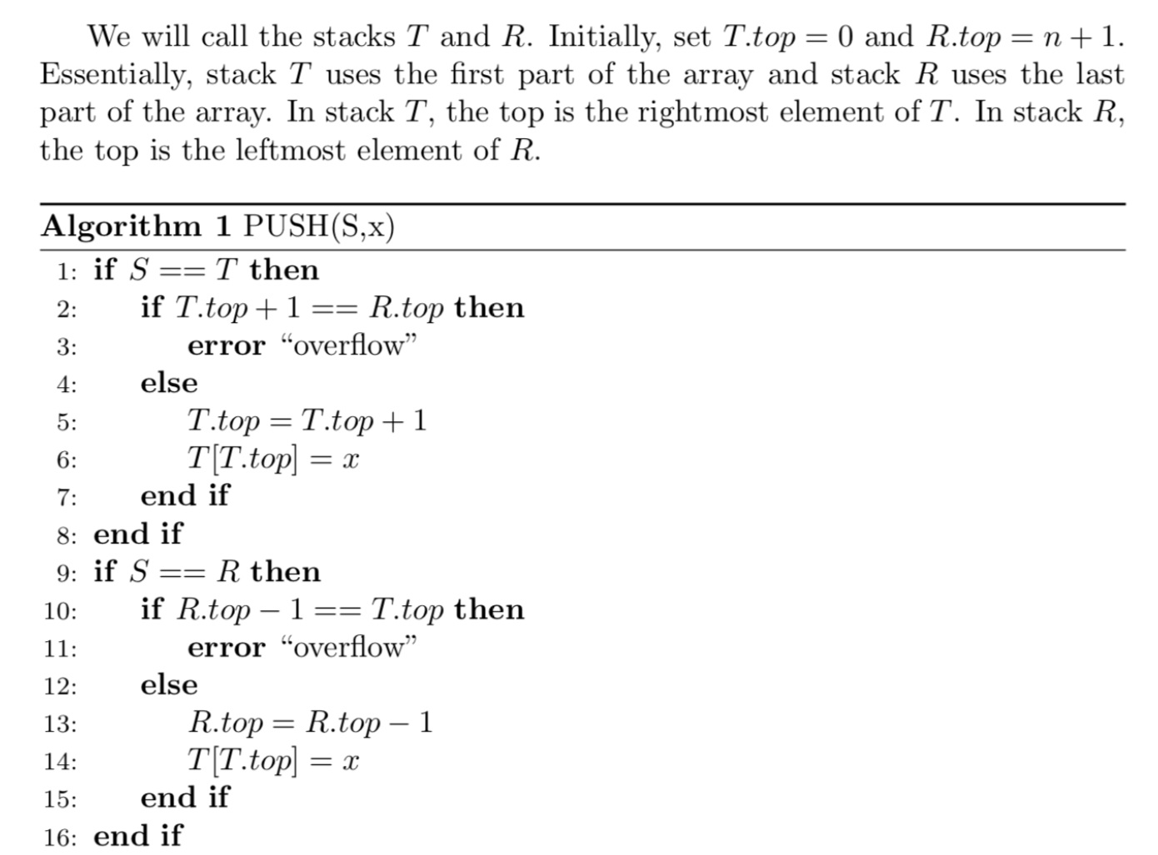
Solution

Slide 13
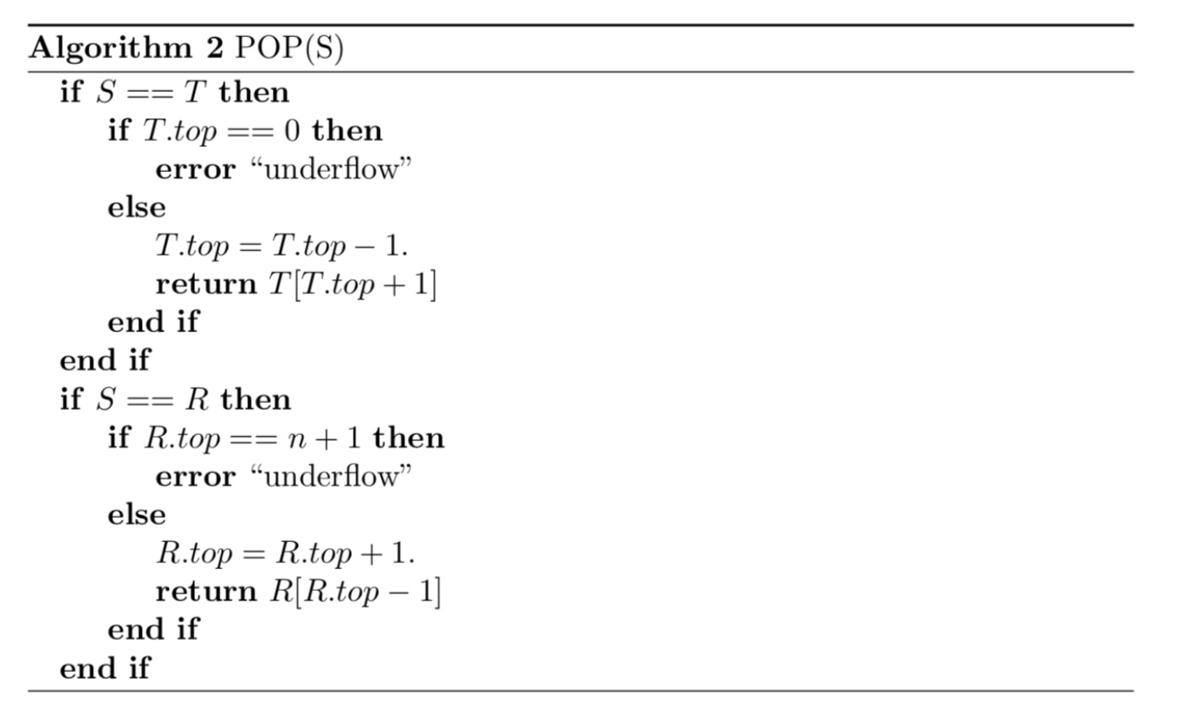

Slide 14
Queue (Sor) Representation
A queue is a FIFO (First In First Out) data structure.
Elements are inserted at the tail and removed from the head.
Often implemented using a cyclic array.

Slide 15
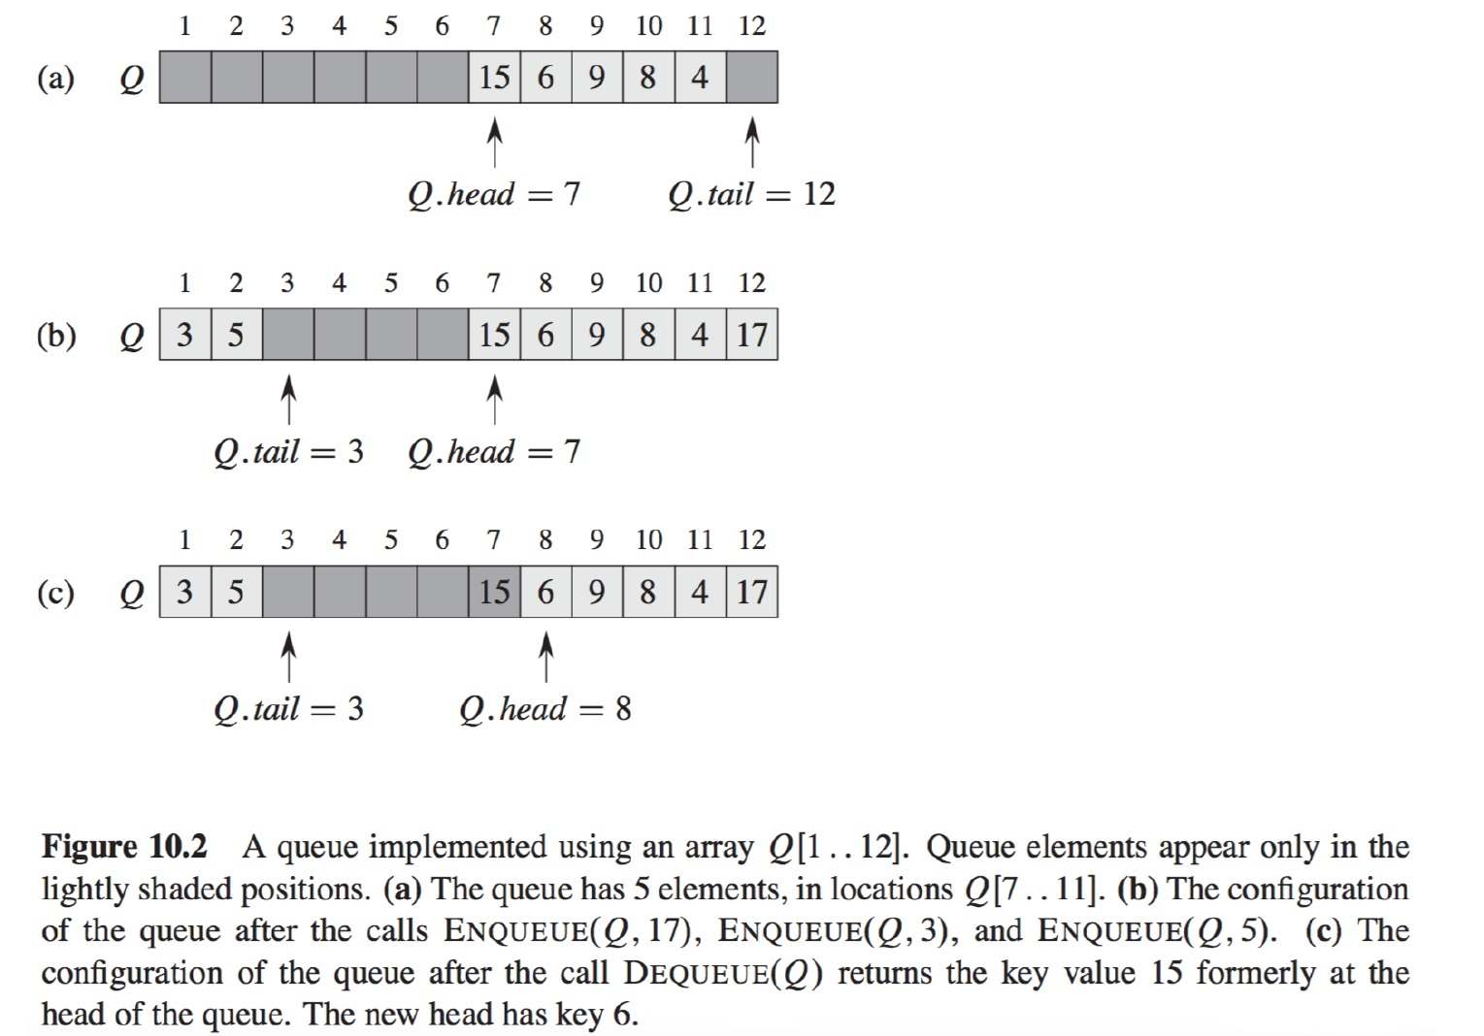

Slide 16
Queue Representation – Exercise 1
Illustrate the result of each operation in the sequence
ENQUEUE(Q,4)
DEQUEUE(Q)
ENQUEUE(Q,7)
ENQUEUE(Q,2)
ENQUEUE(Q,9)
ENQUEUE(Q,5)
ENQUEUE(Q,3)
DEQUEUE(Q)
ENQUEUE(Q,1)
on an initially empty cyclic queue Q stored in array Q[1...6].

Slide 17
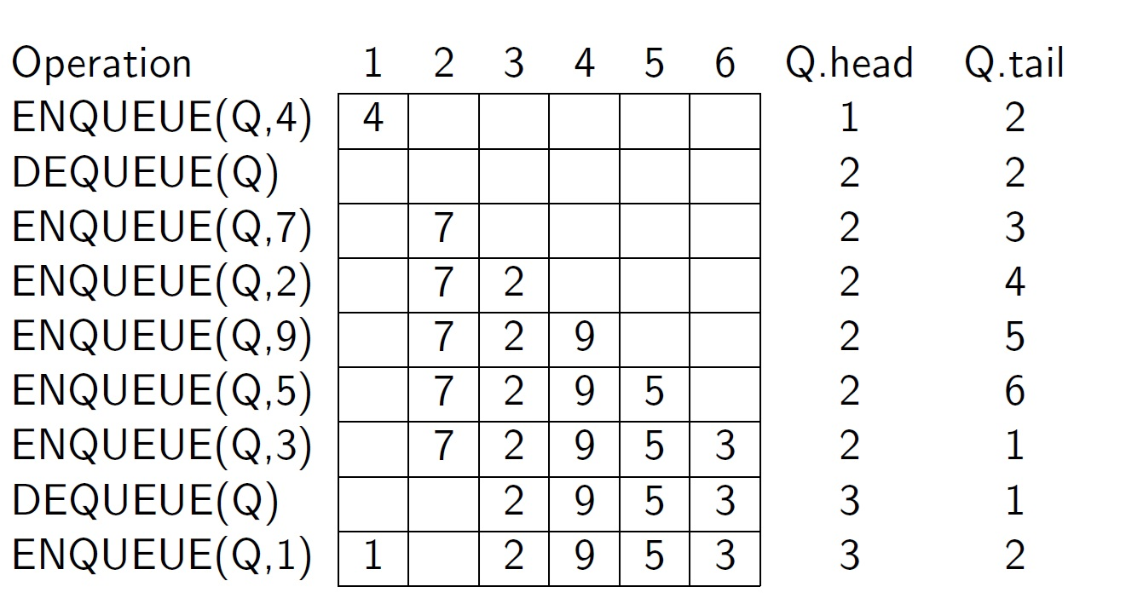
Solution

Slide 18
Queue Representation – Exercise 2
Illustrate the result of each operation in the sequence
ENQUEUE(Q,5)
ENQUEUE(Q,1)
ENQUEUE(Q,7)
DEQUEUE(Q)
ENQUEUE(Q,3)
ENQUEUE(Q,8)
DEQUEUE(Q)
ENQUEUE(Q,2)
ENQUEUE(Q,4)
on an initially empty cyclic queue Q stored in array Q[1...5].

Slide 19
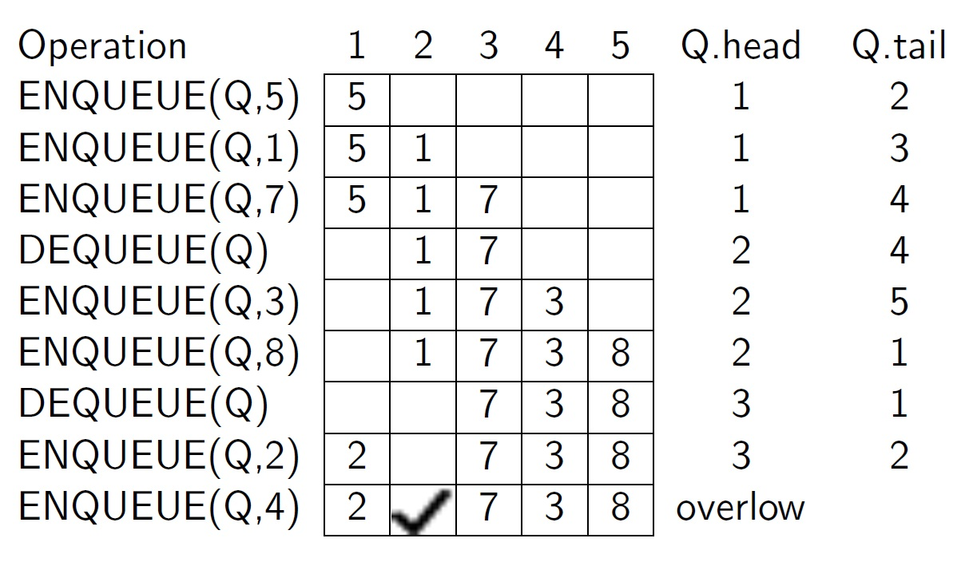
Solution

Slide 20
Queue Representation – Exercise 3
Illustrate the result of each operation in the sequence
ENQUEUE(Q,a)
ENQUEUE(Q,c)
DEQUEUE(Q)
ENQUEUE(Q,b)
DEQUEUE(Q)
DEQUEUE(Q)
ENQUEUE(Q,d)
DEQUEUE(Q)
DEQUEUE(Q)
on an initially empty cyclic queue Q stored in array Q[1...7].

Slide 21
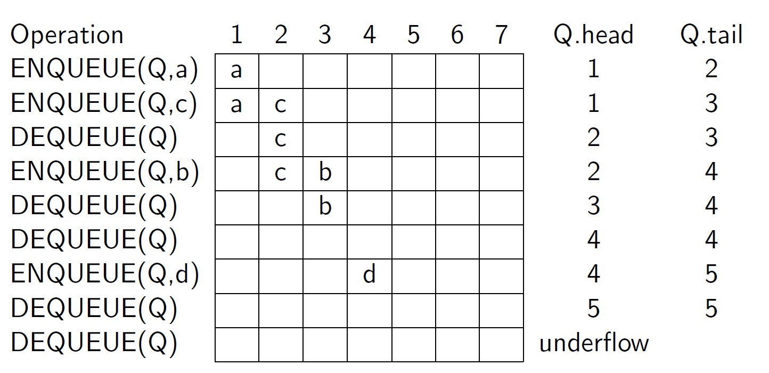
Solution

Slide 22
Queue Representation – Exercise 4
Rewrite ENQUEUE and DEQUEUE.
Both operations should detect:
Queue overflow
Queue underflow

Slide 23
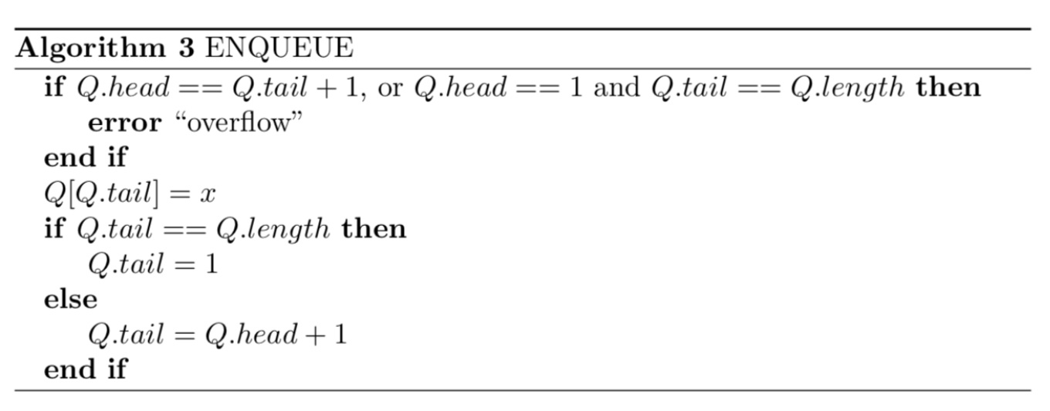
Solution

Slide 24
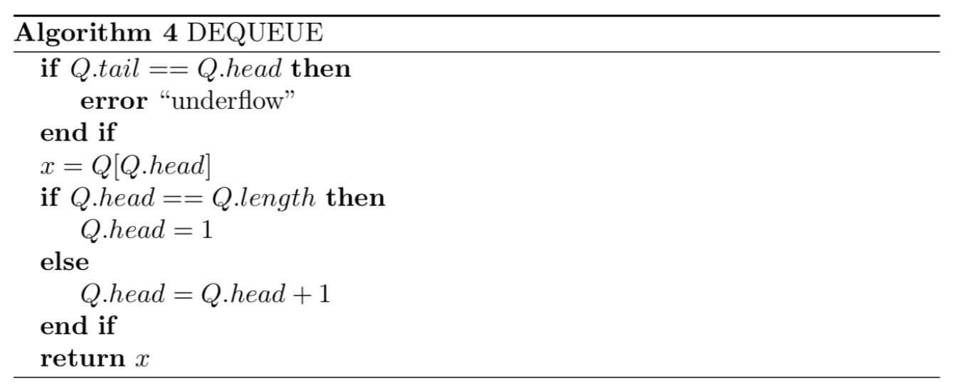

Slide 25
Stacks and Queues – Exercises with Solutions

Slide 26
Exercise 1 – Stack Basics
Given an empty stack, perform the operations:
Push(5), Push(8), Push(2), Pop(), Push(10), Pop()
Question: What is the final content of the stack (top to bottom)?

Slide 27
Solution 1
Operations step-by-step:
Push(5) -> [5]
Push(8) -> [5, 8]
Push(2) -> [5, 8, 2]
Pop() removes 2 -> [5, 8]
Push(10) -> [5, 8, 10]
Pop() removes 10 -> [5, 8]
Final stack (top to bottom): 8, 5

Slide 28
Exercise 2 – Stack Application
Use a stack to check whether the parentheses in the expression are balanced:
((A+B) * (C-D))
Explain the stack operations.

Slide 29
Solution 2
Algorithm:
Push '(' when encountered.
Pop when ')' appears.
Process:
((A+B)*(C-D))
Push ( -> stack: (
Push ( -> stack: ((
) -> pop -> (
Push ( -> ((
) -> pop -> (
) -> pop -> empty
Stack empty → Expression is balanced.

Slide 30
Exercise 3 – Queue Basics
Given an empty queue, perform:
Enqueue(4), Enqueue(7), Enqueue(1), Dequeue(), Enqueue(9), Dequeue()
Question: What elements remain in the queue (front to rear)?

Slide 31
Solution 3
Steps:
Enqueue(4) -> [4]
Enqueue(7) -> [4,7]
Enqueue(1) -> [4,7,1]
Dequeue() removes 4 -> [7,1]
Enqueue(9) -> [7,1,9]
Dequeue() removes 7 -> [1,9]
Final queue (front to rear): 1, 9

Slide 32
Exercise 4 – Queue Conceptual
Explain the difference between stack and queue.
Give one real-world application for each.

Slide 33
Solution 4
Stack:
• Principle: LIFO (Last In First Out)
• Example: Function call stack, undo operations
Queue:
• Principle: FIFO (First In First Out)
• Example: Printer queue, task scheduling

Slide 34
Exercise 5 – Design Problem
Design a queue using two stacks.
Explain the idea of enqueue and dequeue operations.

Slide 35
Solution 5
Use two stacks: Stack1 and Stack2
Enqueue(x):
Push x onto Stack1
Dequeue():
If Stack2 empty:
Move all elements from Stack1 to Stack2
Pop from Stack2
This reverses order and ensures FIFO behavior.

